Slide 1
Embedding and Sketching
Sketching for streaming
Alexandr Andoni (MSR)

Slide 2

Application: Streaming
131.107.65.14
Challenge: log statistics of the data, using small space
18.0.1.12
131.107.65.14
80.97.56.20
IP | Frequency
131.107.65.14 | 3
18.0.1.12 | 2
80.97.56.20 | 2
IP | Frequency
131.107.65.14 | 3
18.0.1.12 | 2
80.97.56.20 | 2
127.0.0.1 | 9
192.168.0.1 | 8
257.2.5.7 | 0
16.09.20.11 | 1
18.0.1.12
80.97.56.20
131.107.65.14

Slide 3
Streaming statistics (norms)
Let x_{i} = frequency of IP i
1st moment (sum): ∑x_{i}
  Trivial: keep a total counter
2nd moment (variance): ∑x_{i}² = ‖x‖₂²
  Can use dimensionality reduction in ℓ₂^{n} !
  Store F(x)=(g₁x, g₂x,… g_{k}x)
    where each g_{i} is a n-dimensional Gaussian random variable
    random g_{i}=(±1, ±1,…±1) also ok
  Update when we see IP i:
    F(x + e_{i}) = F(x) + F(e_{i}) = F(x) + (g₁e_{i}, g₂e_{i},…g_{k}e_{i})
  Space, update time O(k) = O(1/ε²)
    for 90% success
  Do we need to store all g_{i}’s (O(nk) space) ?
    No: each g_{i} need only be 4-wise independent => O(k) words
IP | Frequency
131.107.65.14 | 3
18.0.1.12 | 2
80.97.56.20 | 2
∑x_{i} = 7
∑x_{i}² = 17

Slide 4
Streaming: statistics
Let x_{i} = frequency of IP i
1st moment (sum): ∑x_{i}
  Trivial: keep a total counter
2nd moment (variance): ∑x_{i}² = ‖x‖₂²
  Via dimension reduction
  Keep O(1/ε²) counters [AMS’96]
  Optimal space [IW’03]
p-moment: Σx_{i}^{p} = ‖x‖_{p}^{p}, for p>2
  Can do (and need) Õ(n^{1-2/p}) counters
    [AMS’96, SS’02, BYJKS’02, CKS’03, IW’05, BGKS’06, BO10,AKO’11]
IP | Frequency
131.107.65.14 | 3
18.0.1.12 | 2
80.97.56.20 | 2
∑x_{i} = 7
∑x_{i}² = 17

Slide 5
Streaming: statistics 2
131.107.65.14
80.97.56.20
18.0.1.12
x
18.0.1.12
IP | Frequency
131.107.65.14 | 1
18.0.1.12 | 1
80.97.56.20 | 1
IP | Frequency
131.107.65.14 | 1
18.0.1.12 | 2
y
Question: compute difference in traffic
1st moment: ∑ | x_{i} – y_{i} | = ‖x‖₁
2nd moment: ∑ | x_{i} – y_{i} |² = ‖x‖₂²
‖x‖₁ = 2
‖x‖₂² = 2
Similar Qs: average delay/variance in a network
differential statistics between logs at different servers, etc
Studied in [AMS96, I00, GC07, Li08, NW10, KNW10, KNPW10]

Slide 6
Plan for the rest
Will concentrate on ||x||_{p}^{p} for p>2
Precision Sampling Framework
  A “sampling” algorithm, used for sketching
A sketch for ||x||_{p}^{p} for p>2
[AKO11 -- joint with Robi Krauthgamer (Weizmann Inst.), Krzysztof Onak (CMU)]

Slide 7
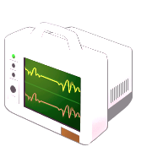

Precision Sampling Framework
Goal: estimating a sum S = ∑ a_{i} (think as if a_{i}=|x_{i}|^{p})
  0 ≤ a_{i} ≤ 1
For each term a_{i}, we get a (rough) estimate ã_{i}
  Up to some precision u_{i}, chosen in advance: |a_{i} – ã_{i}| < u_{i}
Challenge: achieve good trade-off between:
  approximation to S (i.e., get small standard deviation)
  require only weak precisions u_{i} (minimize “cost” of estimating ã_{i})
Compute an estimate S̃ from ã₁, ã₂, ã₃, ã₄
u₁
u₂
u₃
u₄
ã₁
ã₂
ã₃
ã₄
a₁
a₂
a₃
a₄

Slide 8
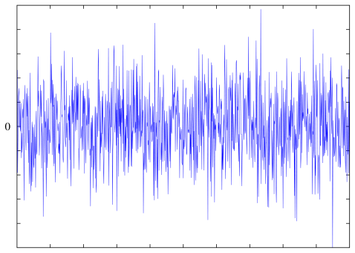
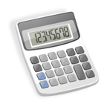
Precision Sampling:
Sum Estimator
Adversary
1. fix precisions u_{i}
1. fix a₁,a₂,…a_{n}
  2. fix ã₁,ã₂,…ã_{n} s.t. |a_{i} – ã_{i}| < u_{i}
3. given ã₁,ã₂,…ã_{n}, output S̃ s.t.
|∑a_{i} – S̃| < 1.
Average cost = 1/n * ∑ 1/u_{i}
  to achieve precision u_{i}, server i uses 1/u_{i} “resources” (e.g., if a_{i} is itself a sum a_{i}=∑_{j}a_{ij} computed by subsampling, then one needs 1/u_{i} samples)
For example, can choose all u_{i}=1/n
  Average cost ≈ n
  Best possible if estimator S̃ = ∑ã_{i}

Slide 9
Precision Sampling Lemma
Goal: estimate ∑a_{i} from {ã_{i}} satisfying |a_{i}-ã_{i}|<u_{i}.
Precision Sampling Lemma: can get, with 90% success:
  ε additive error and 1+ε multiplicative error:
    S – ε < S̃ < (1+ε)*S + ε
  with average cost equal to O(1/ε⁴ * log n)
Example: distinguish Σa_{i}=1 vs Σa_{i}=0
  Consider two extreme cases:
    if one a_{i}=1: all with crude approx (u_{i}=1/3)
    if all a_{i}=1/n: only few with good approx u_{i}=1/n, and the rest with u_{i}=1

Slide 10
Precision Sampling Algorithm
Precision Sampling Lemma: can get, with 90% success:
  O(1/ε³) additive error and 1+O(ε) multiplicative error:
    S – O(1/ε³) < S̃ < (1+O(ε))*S + O(1/ε³)
  with average cost equal to O(log n)
Algorithm:
  Choose each u_{i}∈[0,1] i.i.d.
  Estimator: S̃ = 1/ε * [count of the number of i‘s s.t. ã_{i} / u_{i} > 1/ε ]

Slide 11
Proof of Correctness
Algorithm:
  Choose each u_{i}∈[0,1] i.i.d.
  Estimator: S̃ = 1/ε *[count of the number of i‘s s.t. ã_{i} / u_{i} > 1/ε ]
Proof of correctness:
  X_{i}=1 iff ã_{i} / u_{i} > 1/ε ⬄ ã_{i} > u_{i}*1/ε
  Since |a_{i}-ã_{i}|<u_{i}:
    a_{i} > u_{i}*(1+ε)/ε => X_{i}=1 => a_{i} > u_{i}*(1-ε)/ε
    i.e., we use only ã_{i} which are 1+O(ε) approximation to a_{i}
  E[S̃] =1/ε*∑_{i} E[X_{i}]=1/ε*∑_{i} Pr[a_{i} / u_{i} >(1±ε)/ε] =1/ε∑ a_{i} * ε(1±ε).
  Since X_{i} binary, with 90% success probability:
    |S̃ – E[S̃] | < O(1/ε³) or S̃ = (1±ε)E[S̃]
  E[1/u_{i}] = O(log n) w.h.p.

Slide 12
Precision Sampling Lemma: Full
Precision Sampling Lemma: can get, with 90% success:
  O(1/ε³) additive error and 1+ε multiplicative error:
    S – O(1/ε³) < S̃ < (1+ε)*S + O(1/ε³)
  with average cost equal to O(log n)
Idea:
  Since the expectation of S̃ was “right”, reduce the additive error by repeating the above for O(1/ε⁴) times
  Means to: for each a_{i}, choose O(1/ε⁴) of iid u_{ij}
  Require |a_{i}-ã_{i}|<min_{j} {u_{ij}}.
ε
S – ε < S̃ < (1+ ε)*S + ε
O(1/ε⁴ * log n)

Slide 13
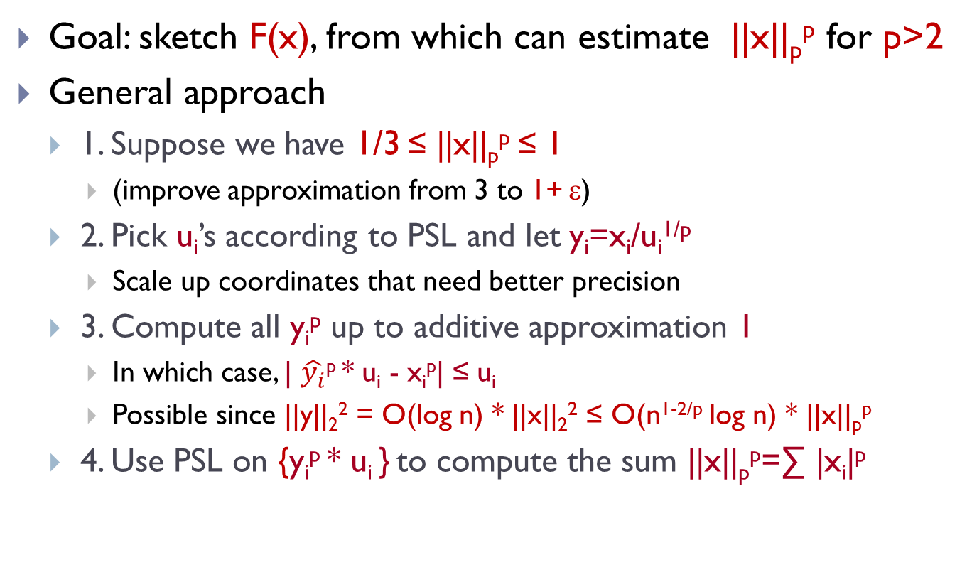
Sketching Norms via Precision Sampling
Goal: sketch F(x), from which can estimate ||x||_{p}^{p} for p>2
General approach
  1. Suppose we have 1/3 ≤ ||x||_{p}^{p} ≤ 1
    (improve approximation from 3 to 1+ ε)
  2. Pick u_{i}’s according to PSL and let y_{i}=x_{i}/u_{i}^{1/p}
    Scale up coordinates that need better precision
  3. Compute all y_{i}^{p} up to additive approximation 1
    In which case, | $\hat{y_{i}}$^{p} * u_{i} - x_{i}^{p}| ≤ u_{i}
    Possible since ||y||₂² = O(log n) * ||x||₂² ≤ O(n^{1-2/p} log n) * ||x||_{p}^{p}
  4. Use PSL on {y_{i}^{p} * u_{i} } to compute the sum ||x||_{p}^{p}=∑ |x_{i}|^{p}

Slide 14
l_{p} moments, p>2
Theorem: linear sketch for l_{p} with O(1) approximation, O(1) update, and O(n^{1-2/p} log² n) space (2/3 succ. prob.).
Sketch:
  Pick random u_{i}∈[0,1], r_{i}∈{±1}, and let y_{i} = x_{i} * r_{i} / u_{i}^{1/p}
  throw into one hash table H,
  m=O(n^{1-2/p} log² n) cells
Estimator:
  Max_{c∈[m]} |H[c]|^{p}
Weak embedding of l_{p}^{n} into l∞^{m} of dim m=O(n^{1-2/p} log² n)
x=
x₁ | x₂ | x₃ | x₄ | x₅ | x₆
y₁+y₃ | y₄ | y₂+y₅+y₆
H=

Slide 15
Analysis
  Consider y_{i} = x_{i} * r_{i} / u_{i}^{1/p}
Claim: max_{i} |y_{i}|^{p} = Θ(1) * ||x||_{p}^{p} with ≥80% probability.
Proof:
  Y_{i}=|y_{i}|^{p} = |x_{i}|^{p}/u_{i}
  M = ||x||_{p}^{p} = ∑_{i} |x_{i}|^{p}
  Upper bound:
    Fixed i: Pr [Y_{i} ≥ 10M] = Pr[x_{i}^{p} / u_{i} ≥ 10M] = x_{i}^{p}/10M
    By union bound: Pr [∃i: Y_{i} ≥ 10M] ≤ ∑_{i} |x_{i}|^{p} / 10M = 1/10.
  Lower bound:
    Fixed i: Pr [Y_{i} ≥ M/5] = Pr[x_{i}^{p} / u_{i} ≥ M/5] > 5x_{i}^{p}/M
    Pr [∃i: Y_{i} ≥ M/5] = 1-∏_{i}(1-5|x_{i}|^{p} /M) ≥ 1 - exp[- 5∑_{i} |x_{i}|^{p} /M] ≥ 0.9

Slide 16
  Analysis (continued)
x=
x₁ | x₂ | x₃ | x₄ | x₅ | x₆
y₁+y₃ | y₄ | y₂+y₅+y₆
Want to show:
  max_{c∈[m]} |H[c]|^{p} = Θ(1) * M
Consider a hash table H, and the cell c where y_{i*} falls into
  For i* which maximizes y_{i*}
How much “extra stuff” is there?
  δ² = (H(c)-y_{i*})² = (∑_{j≠i*} y_{j*} * χ[j→c])²
  E[δ²] = ∑_{j≠i*} y_{j}² * χ[j→c] =∑_{j≠i} y_{j}² / m ≤ ||y||₂²/m
  We have: E_{u}||y||₂² ≤ E_{u} [1/u^{2/p}] * ||x||₂² = O(log n) * ||x||₂²
  ||x||₂² ≤ n^{1-2/p} ||x||_{p}²
  By Markov’s: δ² ≤ M^{2/p} * O(n^{1-2/p} * log n) / m with prob 0.9.
    Choose m s.t. O(n^{1-2/p} * log n) / m < 1 / 5log n
    Then: (H(c))^{p} = (y_{i*}+δ)^{p} = Θ(1) * M.
H=
y_{i} = x_{i} * r_{i} / u_{i}^{1/p}
where r_{i}∈{±1}

Slide 17
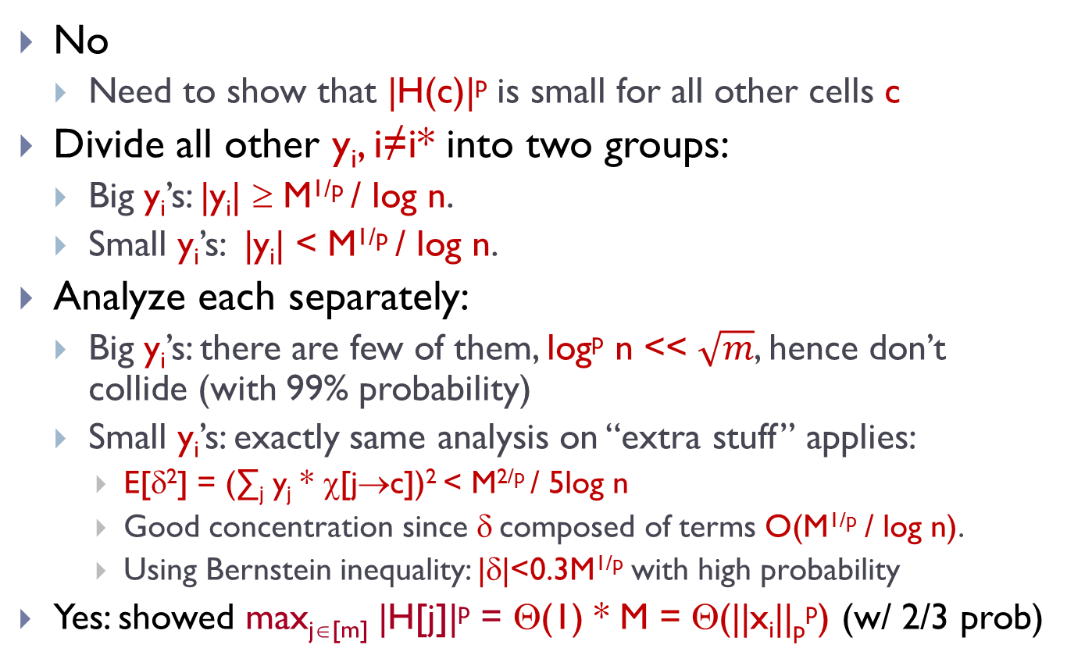
Are we done?
No
  Need to show that |H(c)|^{p} is small for all other cells c
Divide all other y_{i}, i≠i* into two groups:
  Big y_{i}’s: |y_{i}| ≥ M^{1/p} / log n.
  Small y_{i}’s: |y_{i}| < M^{1/p} / log n.
Analyze each separately:
  Big y_{i}’s: there are few of them, log^{p} n << $\sqrt{m}$, hence don’t collide (with 99% probability)
  Small y_{i}’s: exactly same analysis on “extra stuff” applies:
    E[δ²] = (∑_{j} y_{j} * χ[j→c])² < M^{2/p} / 5log n
    Good concentration since δ composed of terms O(M^{1/p} / log n).
    Using Bernstein inequality: |δ|<0.3M^{1/p} with high probability
  Yes: showed max_{j∈[m]} |H[j]|^{p} = Θ(1) * M = Θ(||x_{i}||_{p}^{p}) (w/ 2/3 prob)

Slide 18
Additional Notes
Weak embedding of l_{p}^{n} into l∞^{m} of dimension m=O(n^{1-2/p} log² n), with O(1) distortion
  Weak since works with probability (say) 2/3
Randomness: uses a lot of randomness (bad for streaming), but can reduce using couple more ideas
Same algorithm for all p-moments, including p≤2
  For p>2, gives best space bounds [AMS96, IW05, BGKS06, BO10]
  For p≤2, better bounds are known [AMS96, I00, GC07, Li08, NW10, KNW10, KNPW11]
Algorithms for mixed norms (l_{p} of M) [CM05, GBD08, JW09]
  space bounded by (Rademacher) p-type constant
PSL inspired by [IW05], related to Priority Sampling [DLT04]

Slide 19
Bibliography 1
[AMS96] N. Alon, Y. Matias, M. Szegedy. The space complexity of approximating the frequency moments. STOC96. JCSS 1999.
[IW03] P. Indyk, D. Woodruff. Tight lower bounds for the distinct elements problem. FOCS03.
[SS02] M. Saks, X. Sun. Space lower bounds for distance approximation in the data stream model. STOC02.
[BJKS03] Z. Bar-Yossef, TS Jayram, R. Kumar, D. Sivakumar. An information statistics approach to data stream and communication complexity. JCSS 2004.
[CKS03] A. Chakrabarti, S. Khot, X. Sun. Near-optimal lower bounds on the multi-party communication complexity of set disjointness. CCC03.
[IW05] P. Indyk, D. Woodruff. Optimal approximations of the frequency moments of data streams. STOC05.
[BGKS06] L. Bhuvanagiri, S. Ganguly, D. Kesh, C. Saha. Simpler algorithm for estimating frequency moments of data streams. SODA06.
[BO10] M. Braverman, R. Ostrovsky. Recursive sketching for frequency moments. http://arxiv.org/abs/1011.2571
[AKO11] A. Andoni, R. Krauthgamer, K. Onak. Streaming algorithms from precision sampling. FOCS11. http://arxiv.org/abs/1011.1263

Slide 20
Bibliography 2
[I00] P. Indyk. Stable distributions, pseudorandom generators,
embeddings and data stream computation. FOCS00. JACM 06.
[GC07] S. Ganguly, G. Cormode. On estimating frequency moments of data streams. RANDOM07.
[Li08] P. Li. Estimators and tail bounds for dimension reduction in ell_p (0<p<=2) using stable random projections. SODA08.
[NW10] J. Nelson, D. Woodruff. Fast Manhattan sketches in data streams. PODS10.
[KNW10] D. Kane, J. Nelson, D. Woodruff. On the exact space complexity of sketching small norms. SODA10.
[KNPW10] D. Kane, J. Nelson, E. Porat, D. Woodruff. Fast moment estimation in data streams in optimal space. STOC11.
[CM05] G. Cormode, M. Muthukrishnan. An improved data stream summary: the count-min sketch and its applications. JALG 2005.
[GBD08] S. Ganguly, M. Bansal, S. Dube. Estimating hybrid frequency moments of data streams. In Frontiers in Algorithmics 2008.
[JW09] TS Jayram, D. Woodruff. The data stream space complexity of cascaded norms. FOCS09.
[DLT04] NG Duffield, C. Lund, M. Thorup. Priority sampling for estimation of arbitrary subset sums. JACM 2007.

